Slide 1

Rides Optimization Project
Eugene Cheah
Mengting Yang
Rahil Shah

Slide 2
Problem
Solution
Impact
Progress
Next Steps

Slide 3


Problem
Choices: Uber or Lyft??
Notes:
What you may not be aware about ride sharing is that users can save precious time and money. Our project produces accurately forecasted prices of Uber and Lyft so that ride-sharing will never be the same, whether you’re a driver or a passenger, because users can now make informed decisions based on our app.

Slide 4
Problem
Solution
Impact
Progress
Next Steps

Slide 5


Solution
Data Extraction: APIs of
Real-time and forecasted prices of both ride-sharing services
Notes:
What we’ve been working on is extracting data using Uber and Lyft APIs to performing meaningful data exploration and analyses for predicting trends of both ride-sharing platforms to help users optimize their time and money. We’re developing an application that is akin to Kayak, but for ride-sharing. What if there’s an app just like that can not only inform its users real time prices of all services provided by Uber and Lyft, but also show prices in the future accurately to the 99th percentile.

Slide 6
Problem
Solution
Impact
Progress
Next Steps

Slide 7
Impact
Easier price comparison
Win-win situation
Scope expansion
Notes:
Right now our team can significantly make the process of comparing prices between ride-sharing services much easier and create a win-win situation for both ride-sharing drivers and passengers. In the coming future, we are aiming to expand the app beyond our current perimeter in Boston and Cambridge.

Slide 8
Problem
Solution
Impact
Progress
Next Steps

Slide 9
Progress
Data Collection
Data Visualization
Forecasting with TensorFlow
Forecasting with facebook/prophet

Slide 10
Steps of getting data
1.Get Zipcode in Boston and Cambridge areas
2.Get Locations and Coordinates according to Zip code and Create Yelp database to store data using Yelp API
Notes:
To predict accurately and to restrict the scope of project, we choose the Boston and Cambridge Areas.
Then we use zip codes to categorize different neighbourhoods within these areas to make search easier
We don’t use random coordinates to get locations because they may give problems like parts of oceans,etc.
Instead we use the Yelp API to get proper location. We also create a Yelp database to store the data

Slide 11
Steps of getting data
3.Connect to Yelp Database in Script to get the Start Location and End Location of each ride
4.Get the Weather and Temperature using weather API

Slide 12
Steps of getting data
5.Get data of Uber rides and Lyft rides using Uber API and Lyft API
6.Put script on server to run for one week
Notes:
Then we put all the script in a file and put it on the server

Slide 13
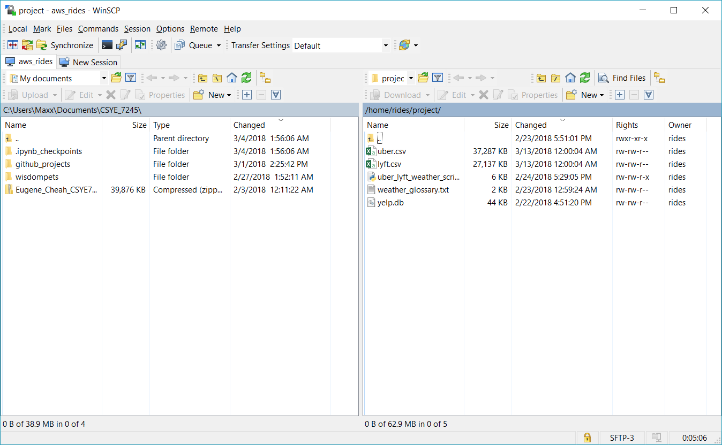
Steps of getting data

Slide 14
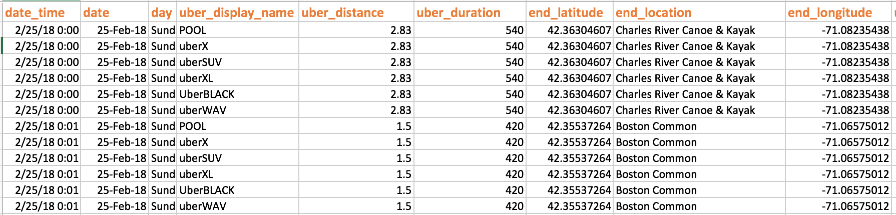
Data Snippet
Data

Slide 15
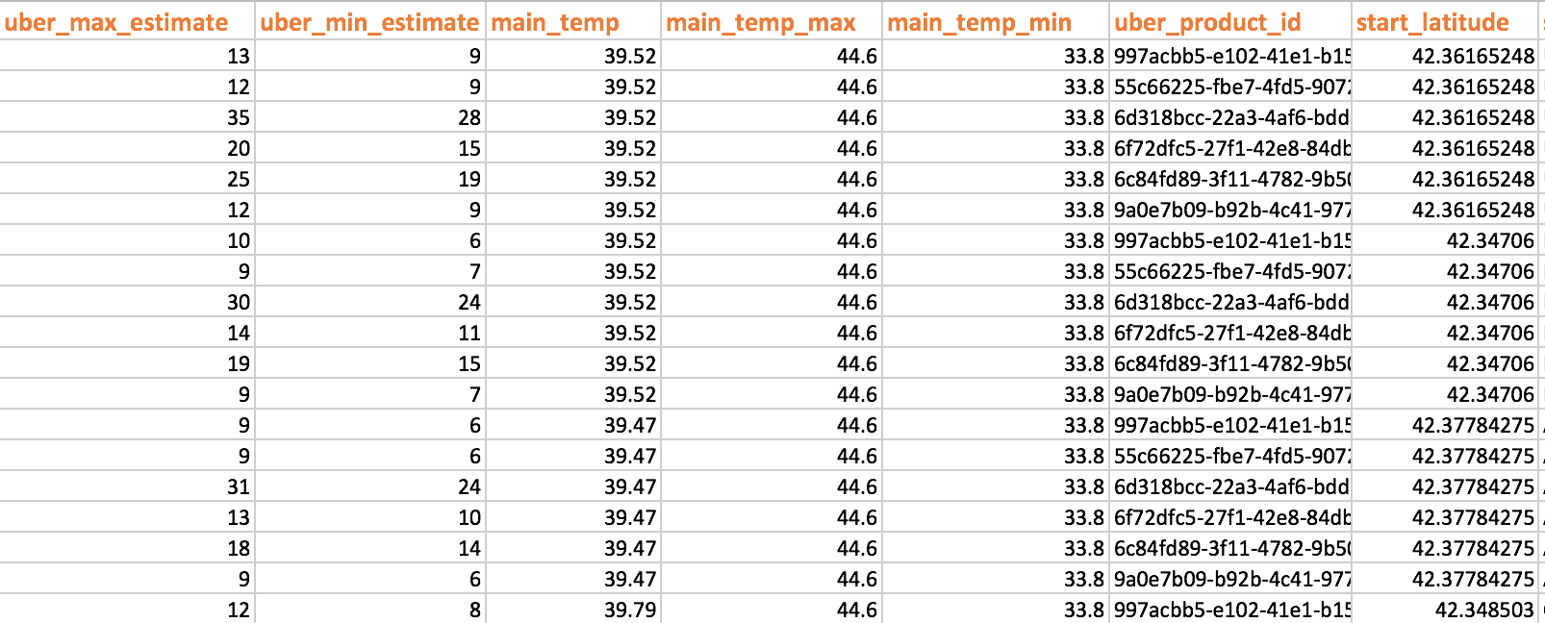
Data

Slide 16
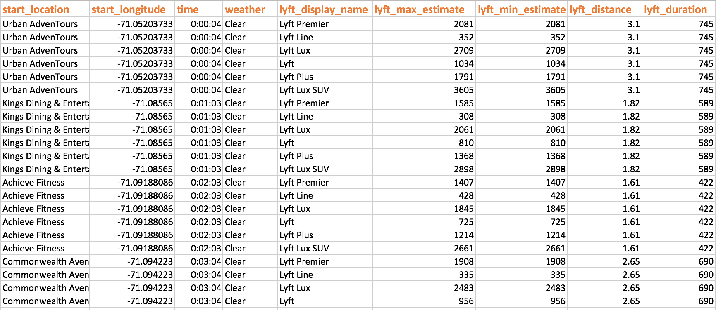
Data

Slide 17
Progress
Data Collection
Data Visualization
Forecasting with TensorFlow
Forecasting with facebook/prophet

Slide 18
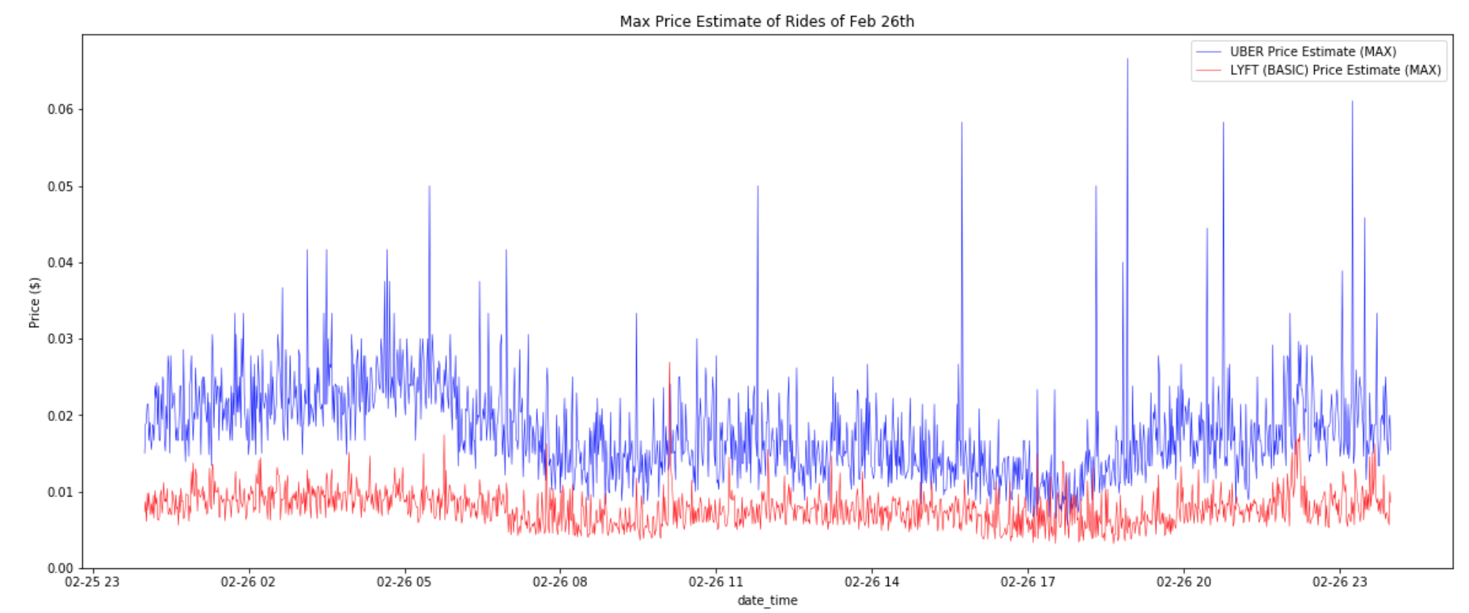
Visualization
Notes:
This is the [ per second ] price of uber and lyft on Feb 26th (Monday)

Slide 19
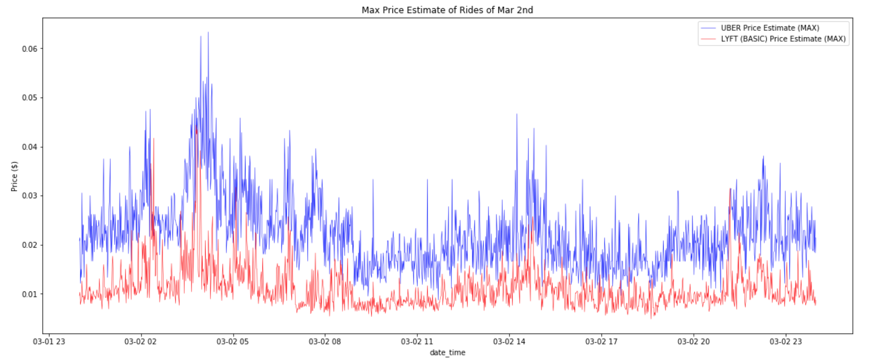
Visualization
Notes:
This is the [ per second ] price of uber and lyft on Mar 2nd (Friday)

Slide 20
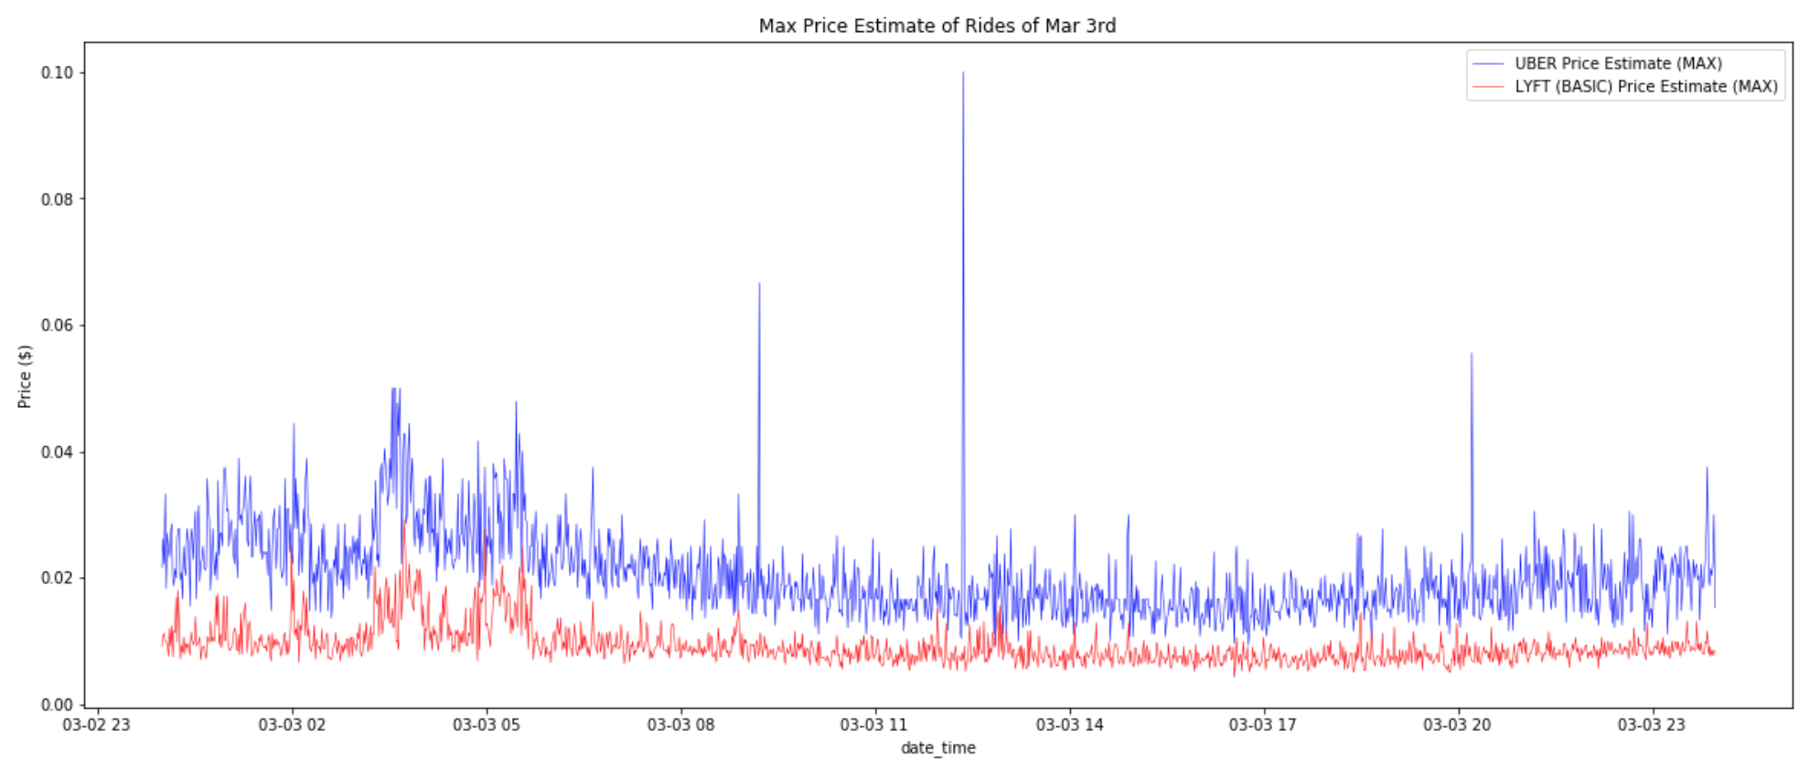
Visualization
Notes:
This is the [ per second ] price of uber and lyft on Mar 3rd (Saturday)

Slide 21
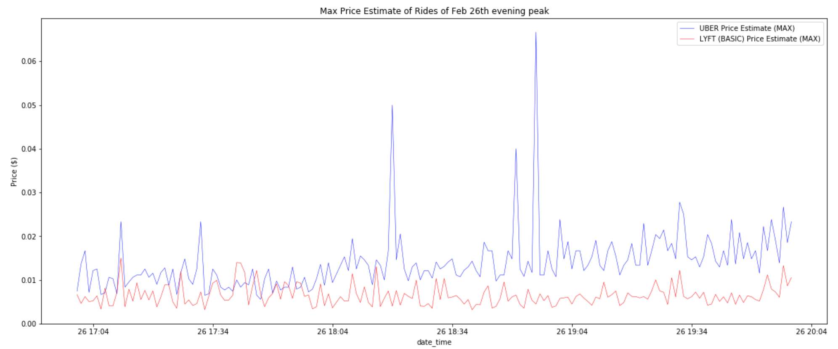
Visualization
Notes:
This is the [ per second ] price of uber and lyft on Feb 26th of Evening high peak to go to work or school from 17:00 to 20:00

Slide 22
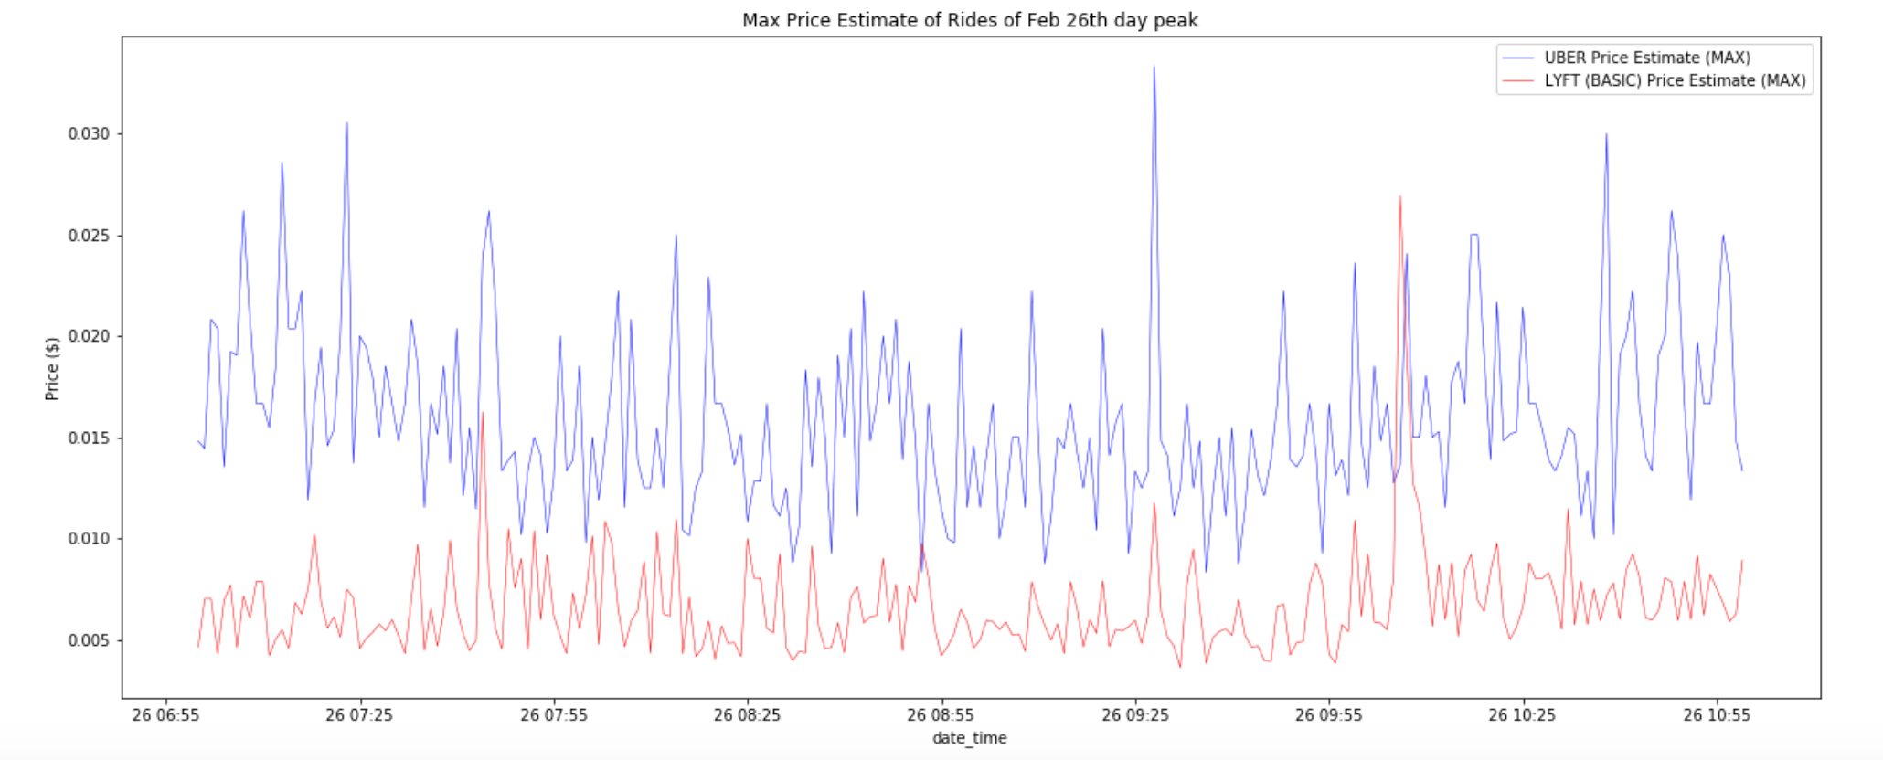
Visualization
Notes:
This is the [ per second ] price of uber and lyft on Feb 26th of Morning high peak from 07:00 to 11:00

Slide 23
Visualization
Notes:
This is the [ per second ] price of uber and lyft on Feb 26th of Morning high peak from 07:00 to 11:00

Slide 24
Progress
Data Collection
Data Visualization
Forecasting with TensorFlow
Forecasting with facebook/prophet

Slide 25
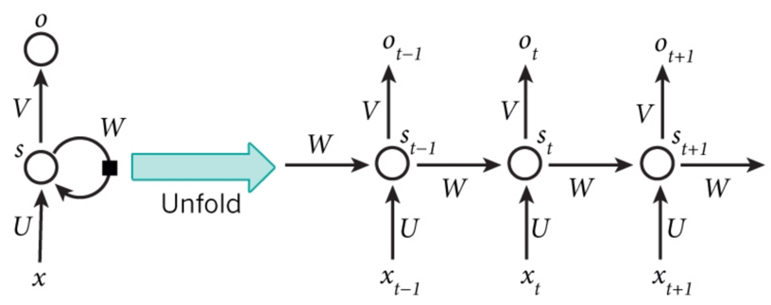
Forecasting Time Series with TensorFlow
Recurrent Neural Networks (RNNs)
Notes:
Recurrent Neural Networks (RNNs) are a class of neural networks that depend on the sequential nature of their input. In this case, time series.
Recurrent Neural Networks (RNNs) are called recurrent because they perform the same computations for all elements in a sequence of inputs

Slide 26
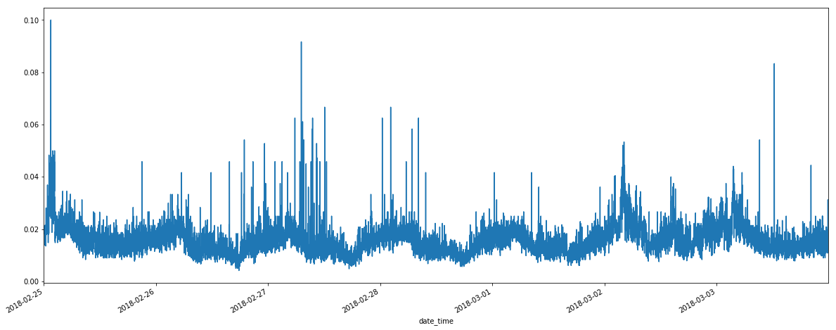
Forecasting Time Series with TensorFlow
UberPOOL Time Series Example

Slide 27
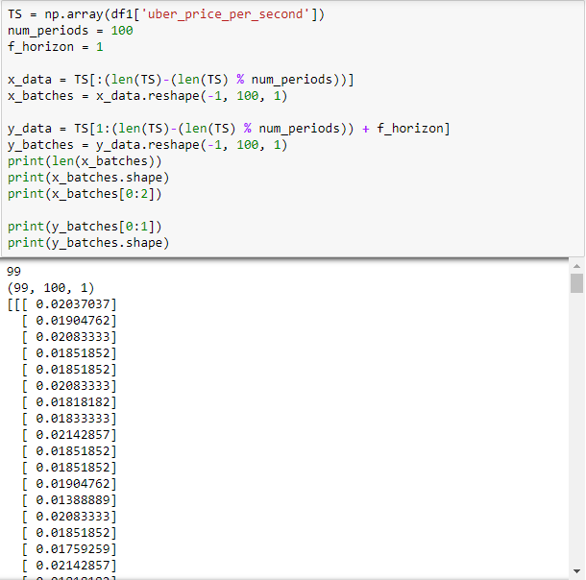
Forecasting Time Series with TensorFlow
Notes:
Convert data into array that can be broken up into training ‘batches’ that we will feed into our RNN model. We have around 9900 observations in our data, so what we see is our training data set is made up of 99 batches, containing 100 observations, where each observation is a sequence of a single value.

Slide 28
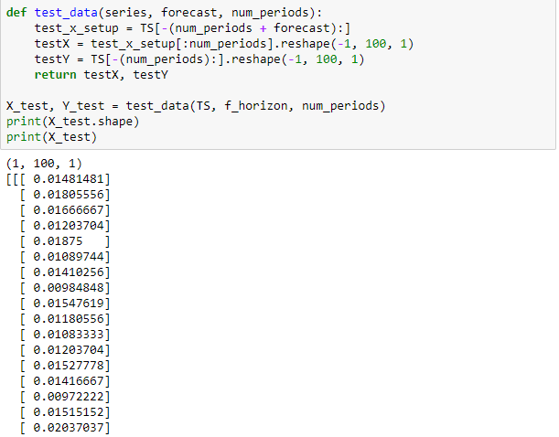
Forecasting Time Series with TensorFlow
Notes:
Pulling out our test data

Slide 29
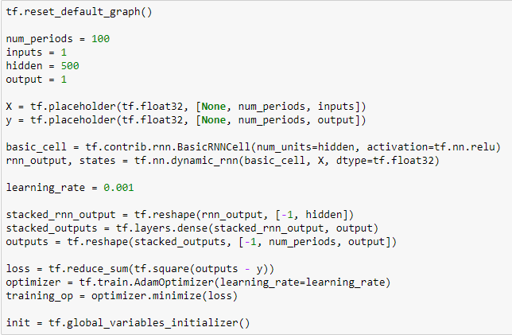
Forecasting Time Series with TensorFlow
Notes:
There is a lot going on there, so let's examine one step at a time. We are specifying the number of periods we are using to predict. In this case, it is the number of sequences that we are feeding into the model as a single input. We specify our variable placeholders. We initialize a type of RNN cell to use (size 500) and the type of activation function we want. ReLU stands for “Rectified Linear Unit” and is the default activation function. We want our outputs to be in the same format as our inputs so we can compare our results using the loss function. In this case, we are using mean squared error (MSE), since this is a regression problem, in which our goal is to minimize the difference between the actual and the predicted. Now that we have this loss function defined, it is possible to define the training operation in TensorFlow that will optimize our network of input and outputs. To execute the optimization, we will use the Adam optimizer. Adam optimizer is a great general-purpose optimizer that performs our gradient descent via backpropagation through time. This allows faster convergence at the cost of more computation.

Slide 30
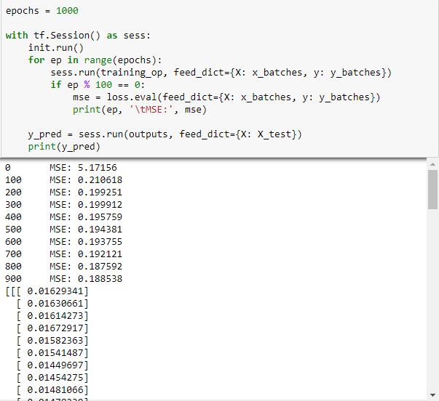
Forecasting Time Series with TensorFlow
Notes:
We specify the number of iterations/epochs that will cycle through our batches of training sequences. We create our graph object (tf.Session()) and initialize our data to be fed into the model as we cycle through the epochs. The abbreviated output shows the MSE after each 100 epochs. As our model feeds the data forward and backpropagation runs, it adjusts the weights applied to the inputs and runs another training epoch. Our MSE continues to improve (decrease). Finally, once the model is done, it takes the parameters and applies them to the test data to give us our predicted output for Y.

Slide 31
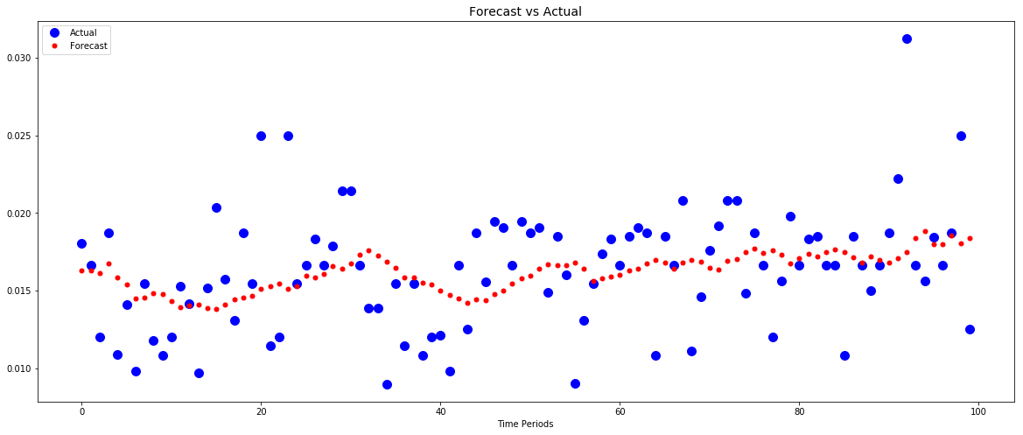
Forecasting Time Series with TensorFlow
Notes:
Let’s check our predicted versus actual. For our test data, we were focused on the last 100 periods of the entire 9900 periods. It would appear there is some room for improvement, and this can be done by changing the number of hidden neurons and/or increasing the number of epochs. We have to optimize it and then automate our analysis.

Slide 32
Progress
Data Collection
Data Visualization
Forecasting with TensorFlow
Forecasting with facebook/prophet

Slide 33

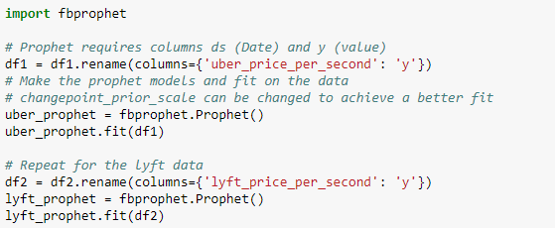
Forecasting Time Series with fbprophet
Notes:
The Facebook Prophet package is designed for analyzing time series with daily observations that display patterns on different time scales.
In prophet, the Date Time column must be called ‘ds’ and the value column we want to predict ‘y’.

Slide 34
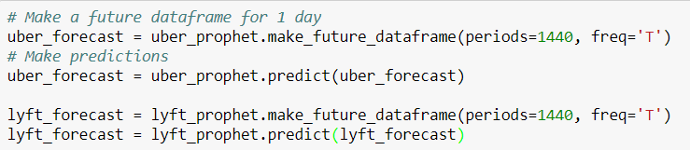
Forecasting Time Series with fbprophet
Notes:
To make forecasts, we need to create what is called a future dataframe. We specify the number of future periods to predict (1 day) and the frequency of predictions (minutely). We then make predictions with the prophet model we created and the future dataframe.

Slide 35
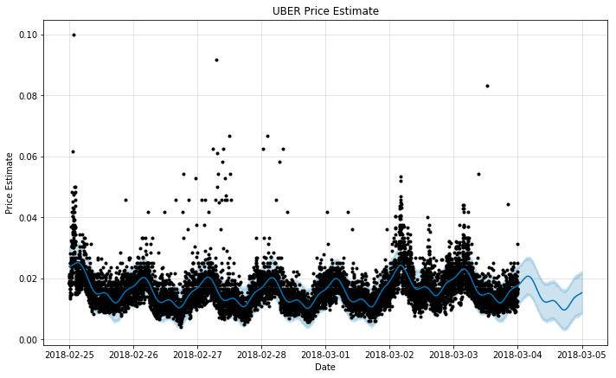
Forecasting Time Series with fbprophet

Slide 36
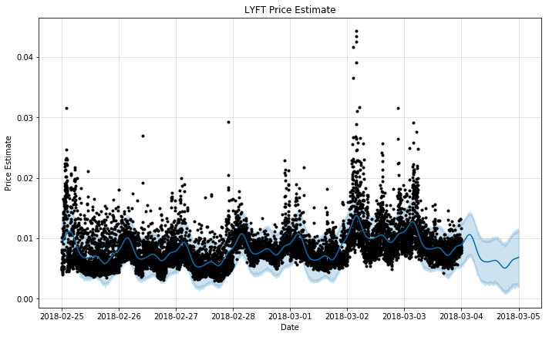
Forecasting Time Series with fbprophet

Slide 37
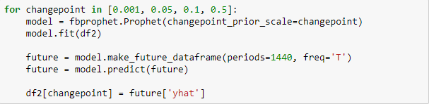
Forecasting Time Series with fbprophet
The changepoint hyperparameter is used to control how sensitive the trend is to changes, with a higher value being more sensitive and a lower value less sensitive.
Notes:
changepoint_prior_scale is used to combat one of the most fundamental trade-offs in machine learning: bias vs. variance.
If we fit too closely to our training data, called overfitting, we have too much variance and our model will not be able to generalize well to new data. On the other hand, if our model does not capture the trends in our training data it is underfitting and has too much bias. When a model is underfitting, increasing the changepoint prior allows more flexibility for the model to fit the data, and if the model is overfitting, decreasing the prior limits the amount of flexibility.

Slide 38
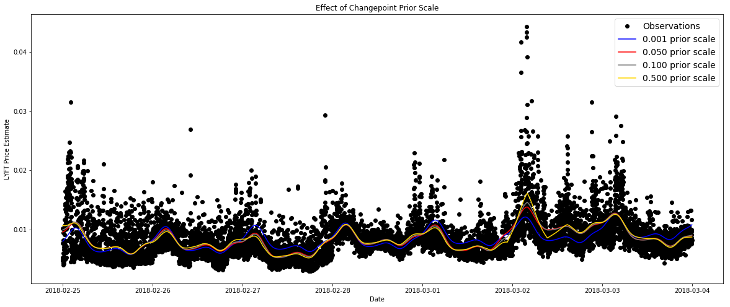
Forecasting Time Series with fbprophet

Slide 39
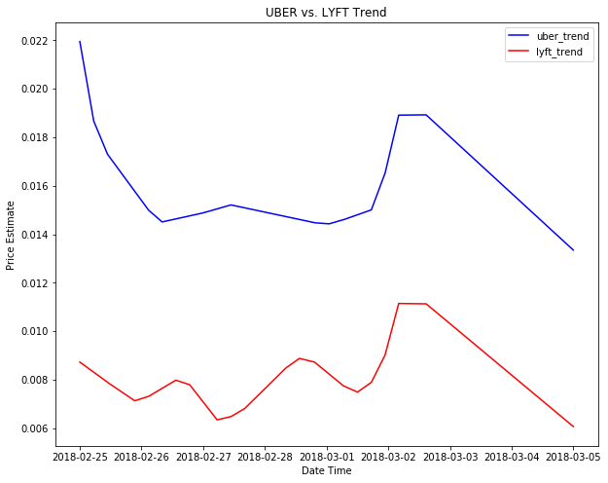
Forecasting Time Series with fbprophet

Slide 40
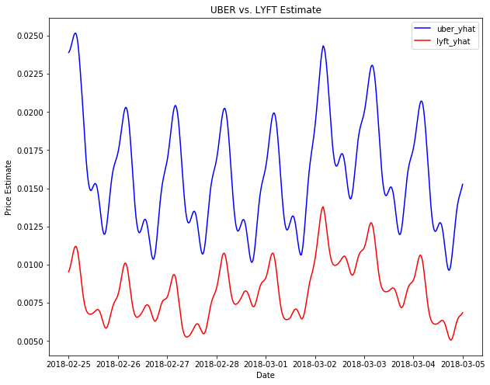
Forecasting Time Series with fbprophet

Slide 41
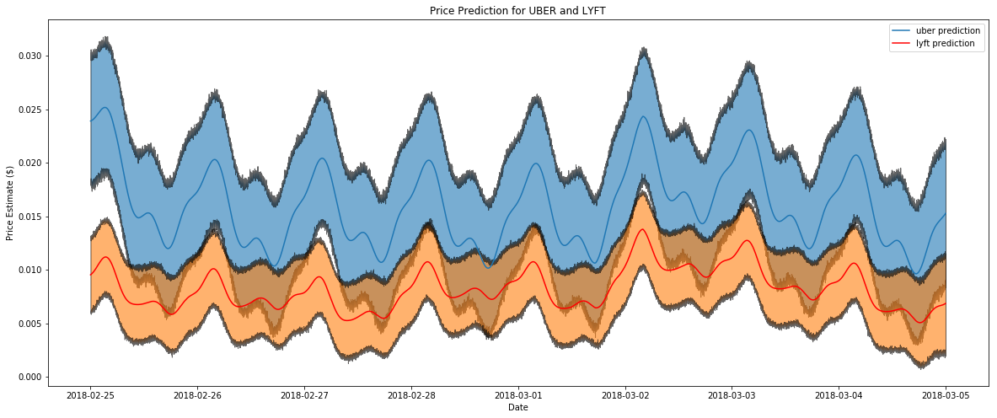
Forecasting Time Series with fbprophet

Slide 42
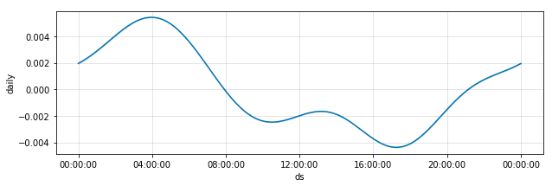
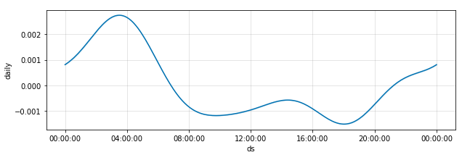
Forecasting Time Series with fbprophet
Notes:
Uber top, lyft bottom
Prophet allows us to easily visualize the overall trend and the component patterns

Slide 43
Problem
Solution
Impact
Progress
Next Steps

Slide 44
Next Steps
More data!
Improve upon current models!
Explore other forecasting techniques!

Slide 45
Q&A

